Slide 1

Advanced Machine Learning
ICT-
By-
Dr. Jesmin Akhter
Professor
Institute of Information Technology
Jahangirnagar University

Slide 2
Contents
The course will mainly cover the following topics:
Ensemble Learning
Unsupervised Learning
Clustering Fundamentals
Hierarchical Clustering
………………………..
Neural Networks and Deep Learning
Notes:
More Supervised - Adaboost Gradient boosting Xgboost

Slide 3
Outline
A Gentle Introduction to Machine Learning

Slide 4
Algorithm for divisive hierarchical clustering
BOOK Lecture Notes in MACHINE LEARNING
Dr V N Krishnachandran
Pages: 215-219

Slide 5
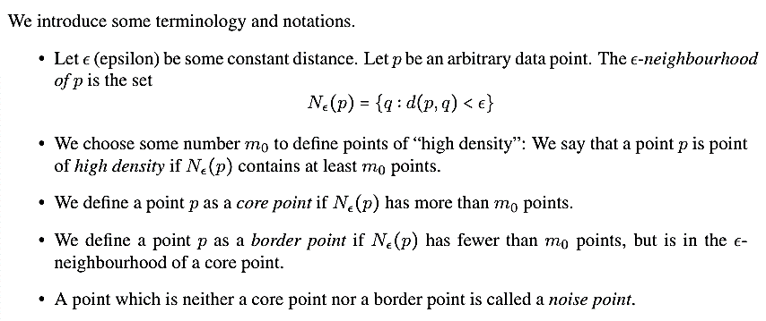
Density

Slide 6
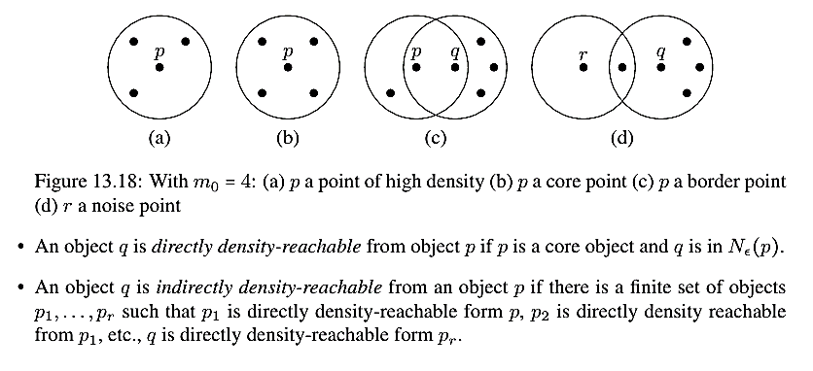

Slide 7
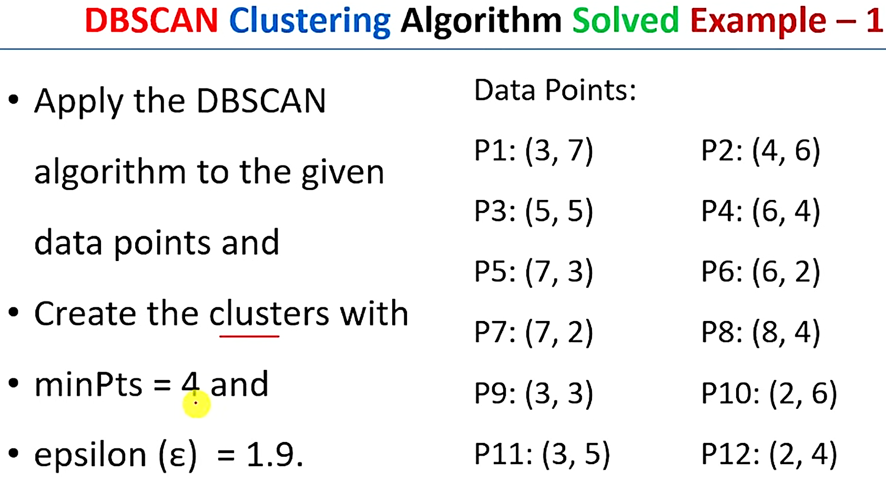
DBSCAN (Density-Based Spatial Clustering of Applications with Noise)

Slide 8
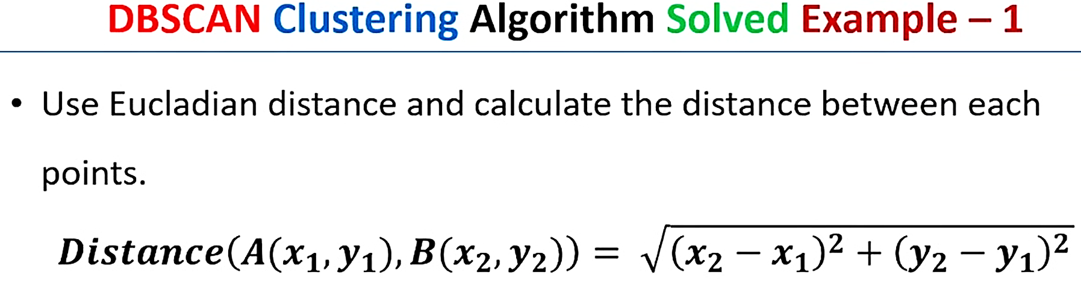

Slide 9
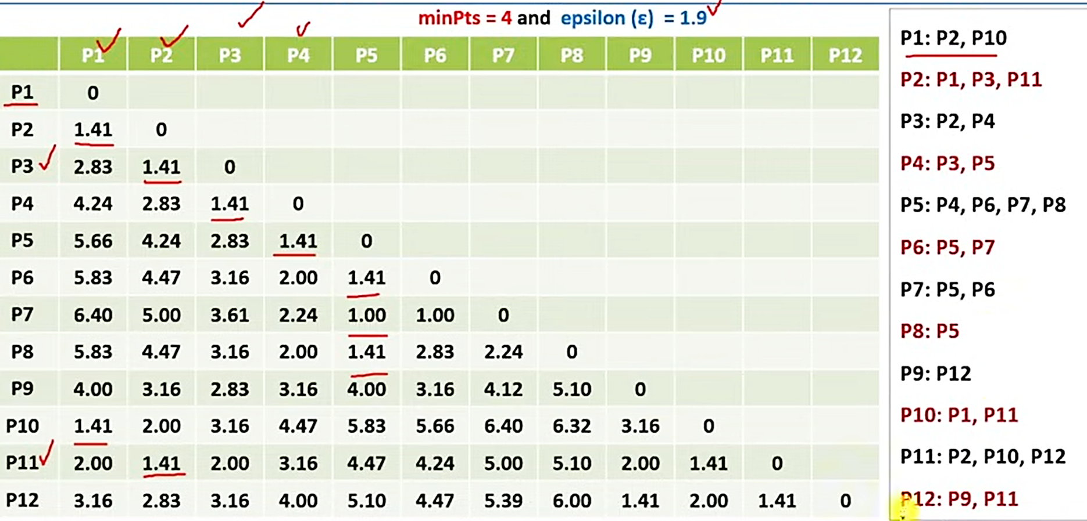

Slide 10
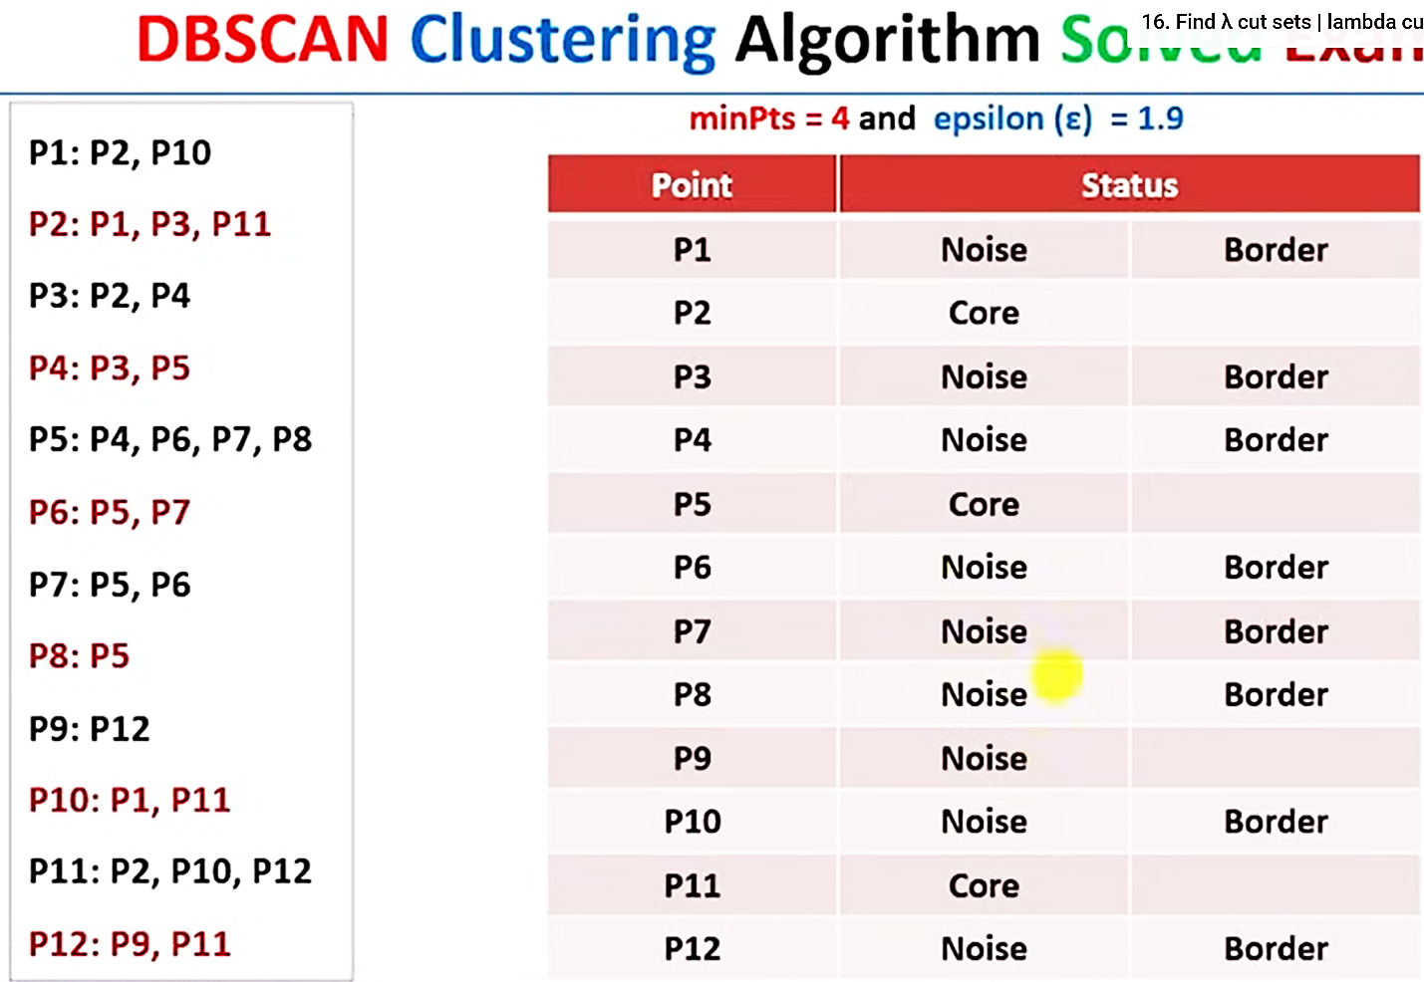

Slide 11
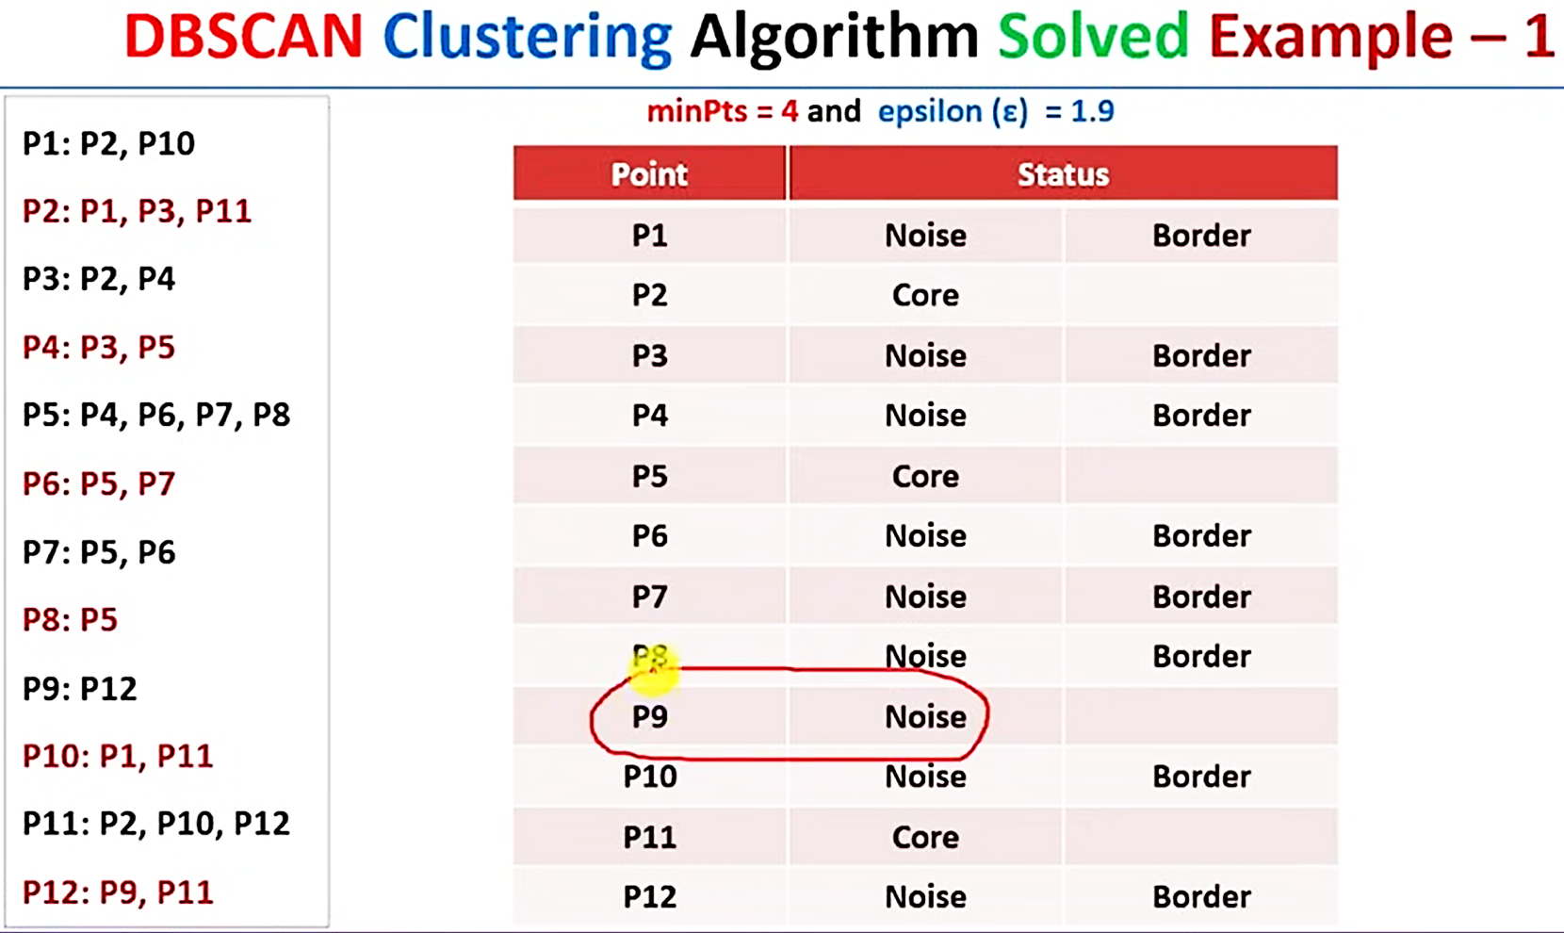

Slide 12
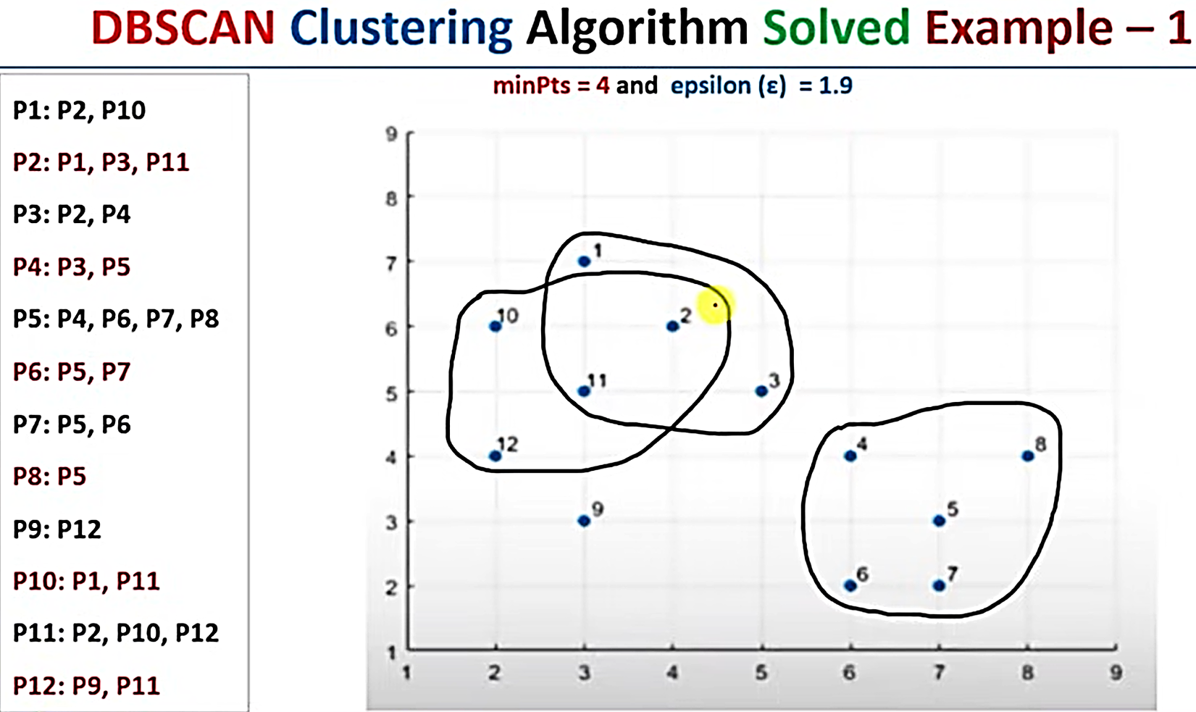

Slide 13
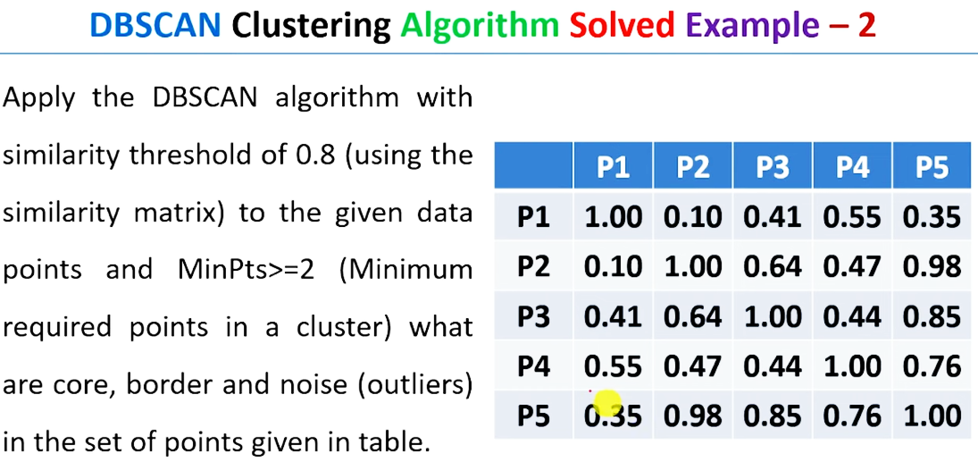

Slide 14
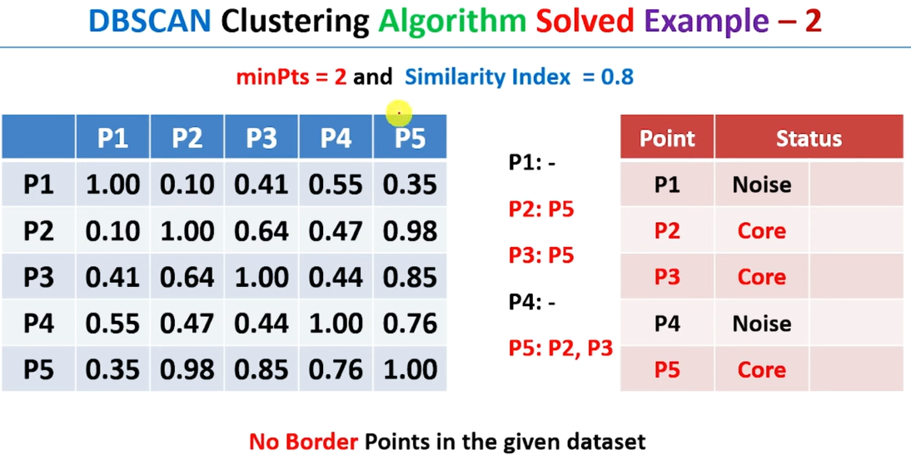

Slide 15
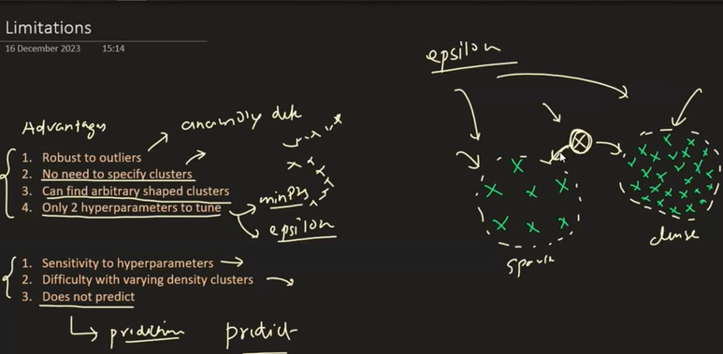

Slide 16
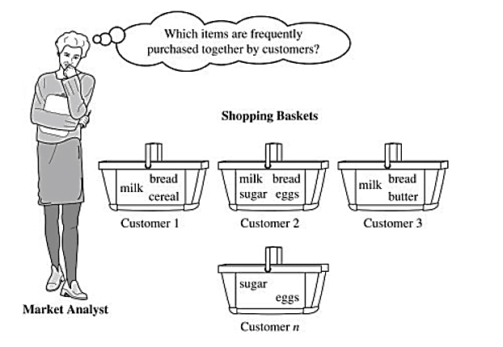
Association Rule Mining
Association rule mining focuses on discovering interesting relationships or patterns between variables in the large database. It determines the set of items that occurs together in the dataset. Association rule makes marketing strategy more effective. Such as people who buy X (suppose a bread) also tend purchase Y (Butter/Jam) item. The widely used algorithm for association rule mining is the Apriori algorithm.
A real-life example of this is market basket analysis, where retailers analyze customer purchase data to identify relationships between products frequently bought together. For instance, this analysis might reveal that customers who purchase diapers also tend to buy baby wipes
Notes:
https://kaumadiechamalka100.medium.com/apriori-algorithm-f7fb30793274

Slide 17
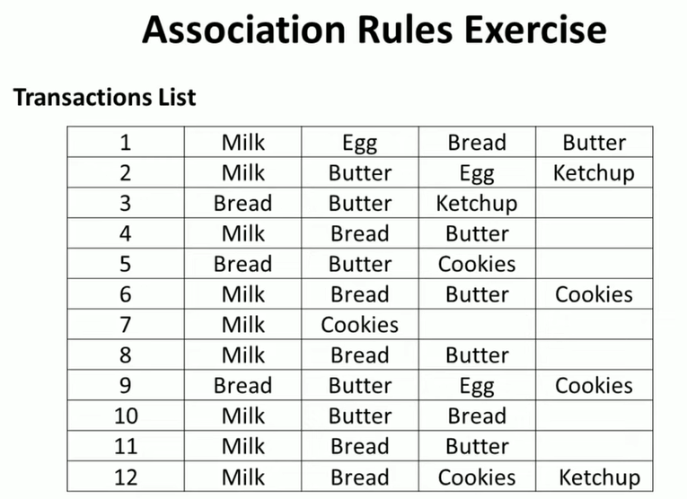

Slide 18
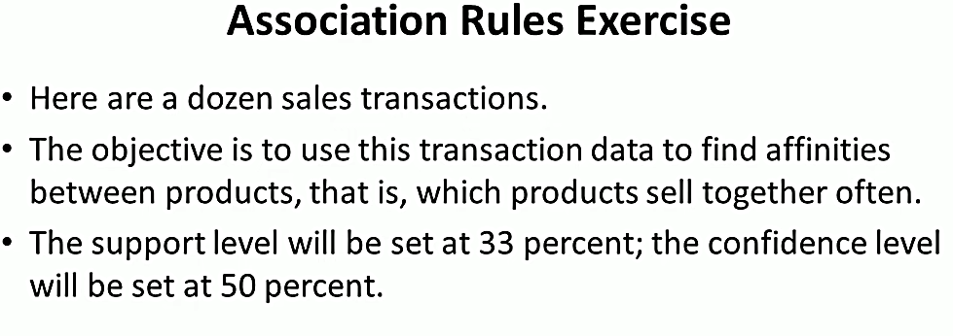
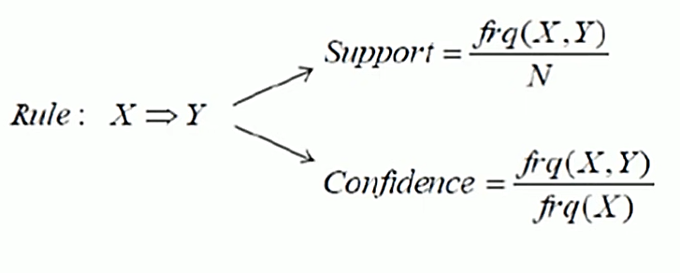

Slide 19
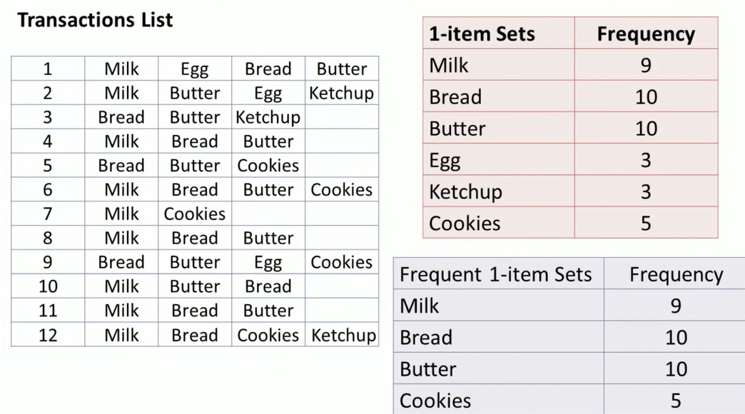

Slide 20
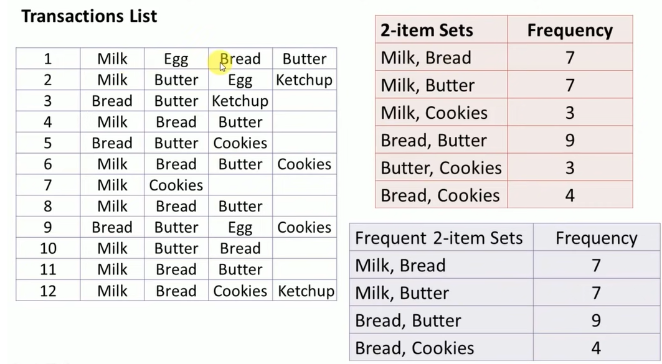

Slide 21
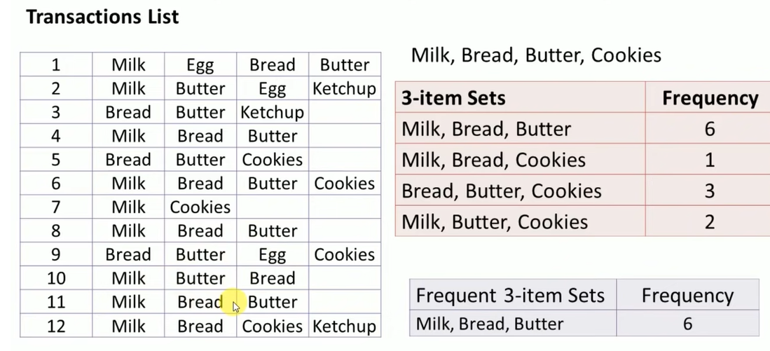

Slide 22
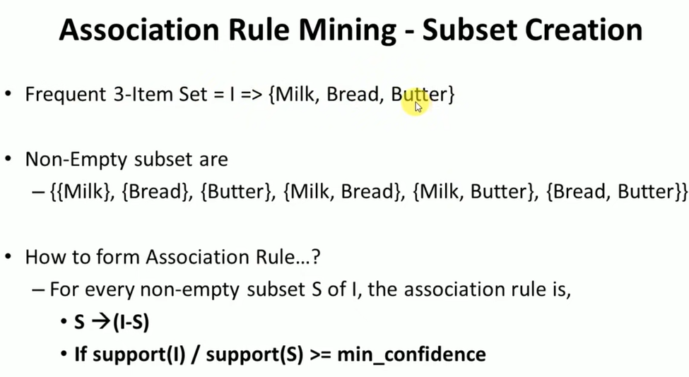

Slide 23
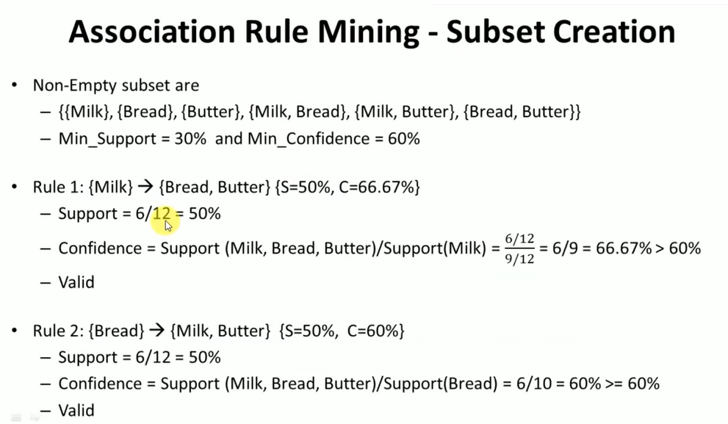

Slide 24
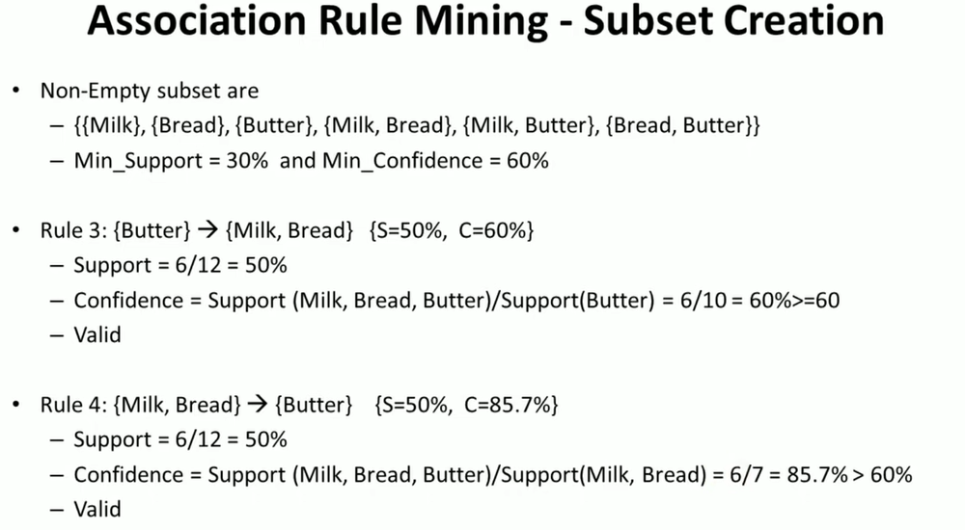

Slide 25
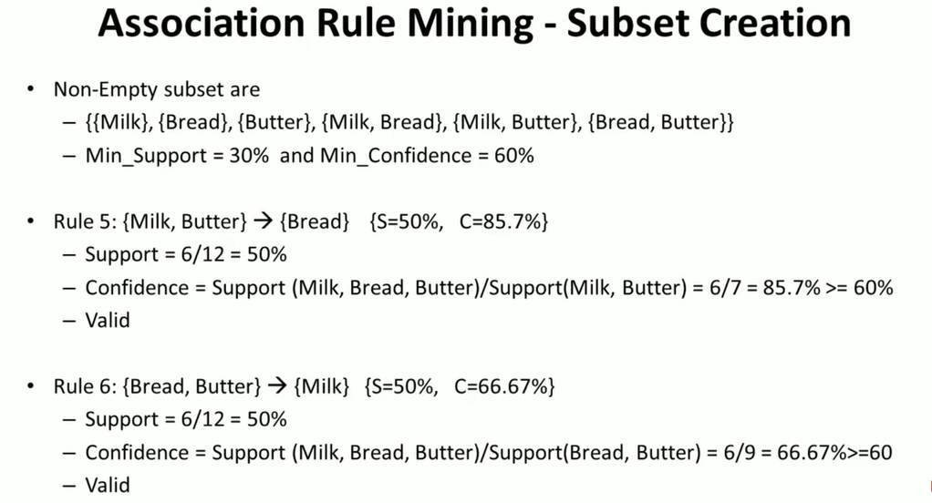

Slide 26
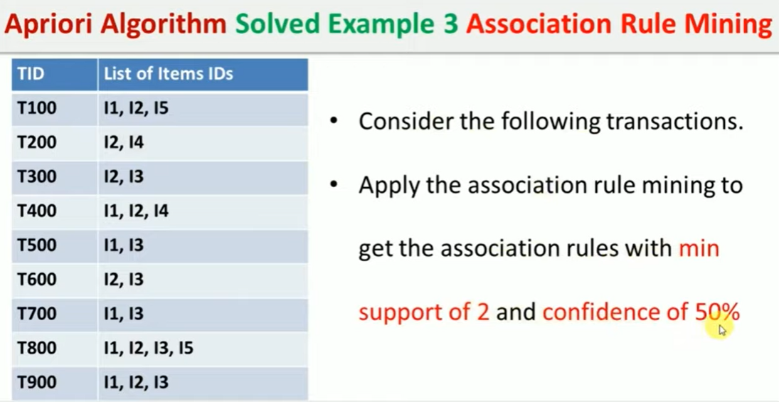

Slide 27
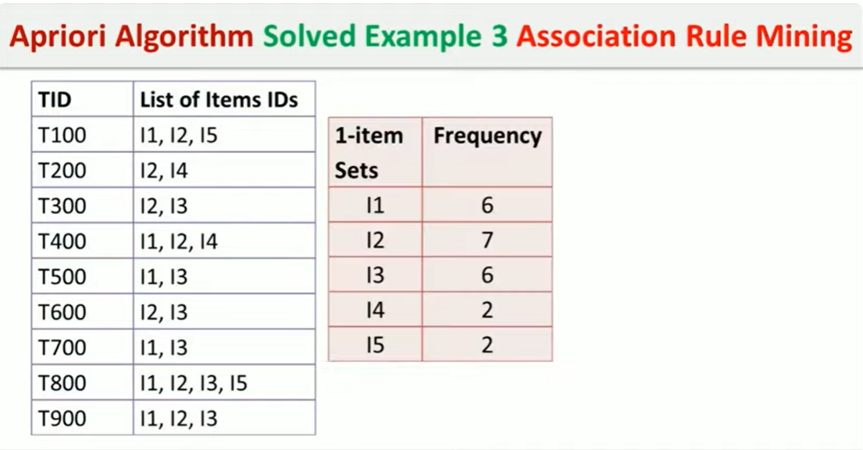

Slide 28
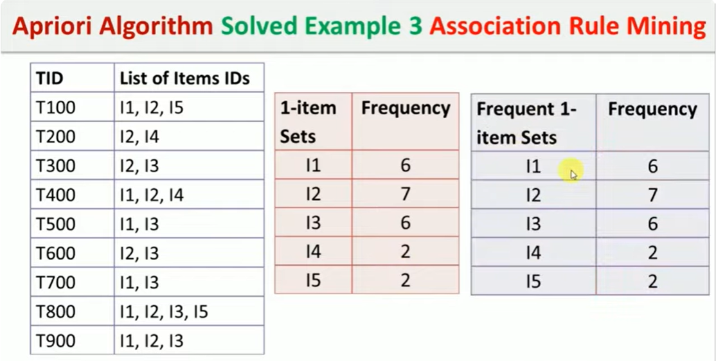

Slide 29
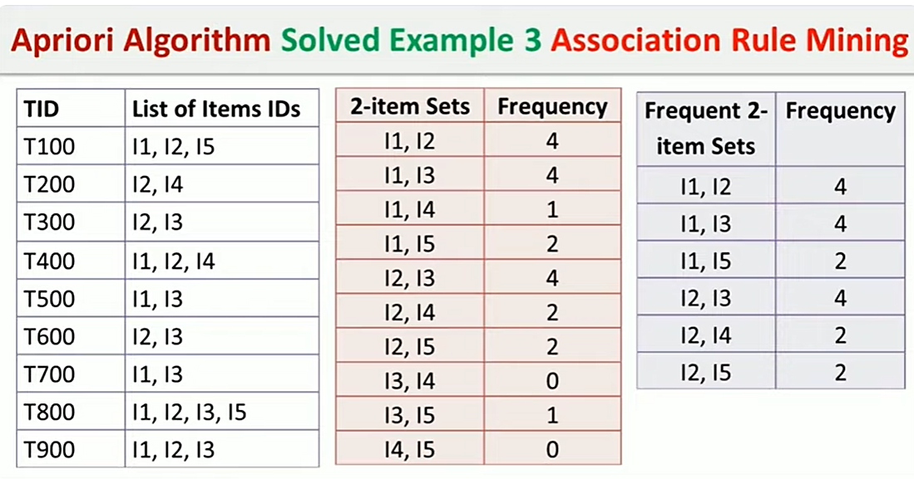

Slide 30
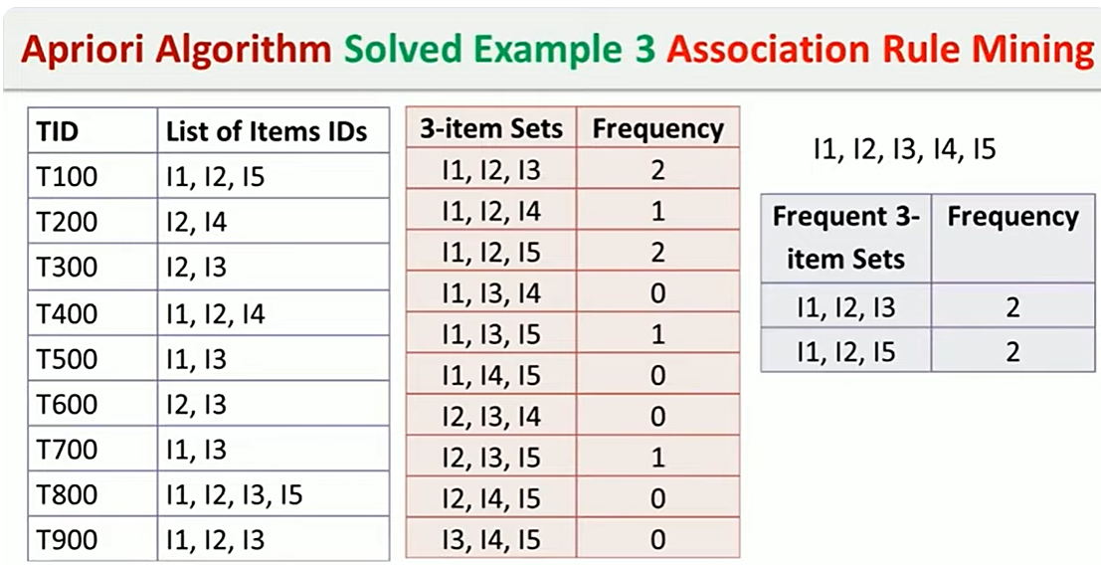

Slide 31
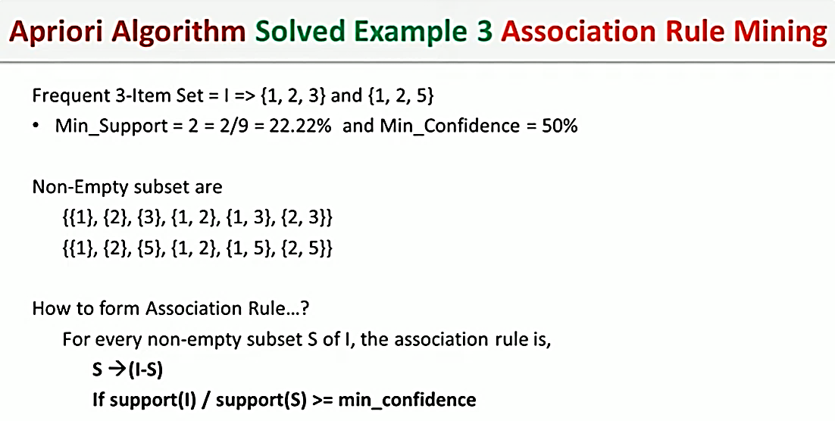

Slide 32
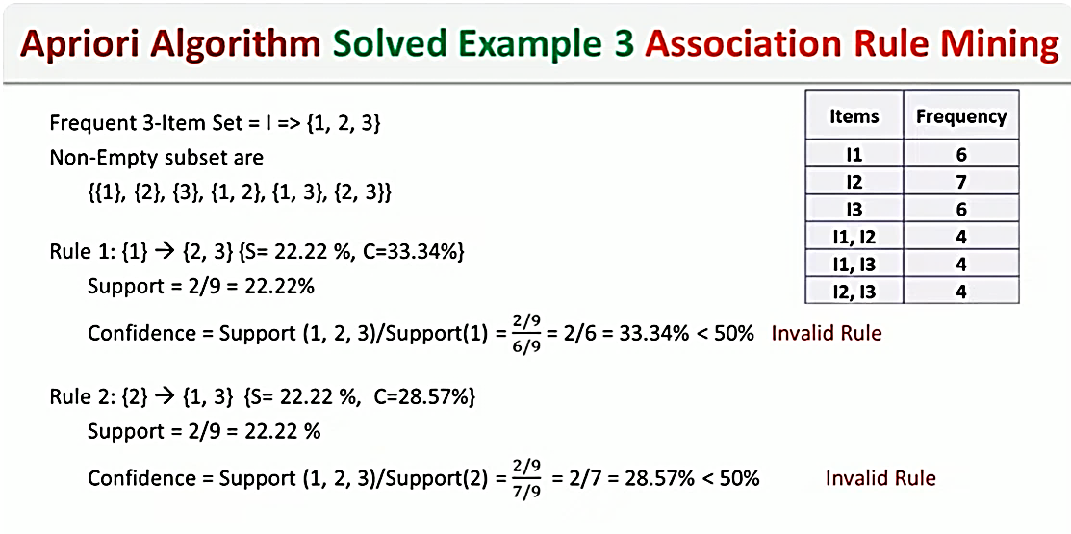

Slide 33
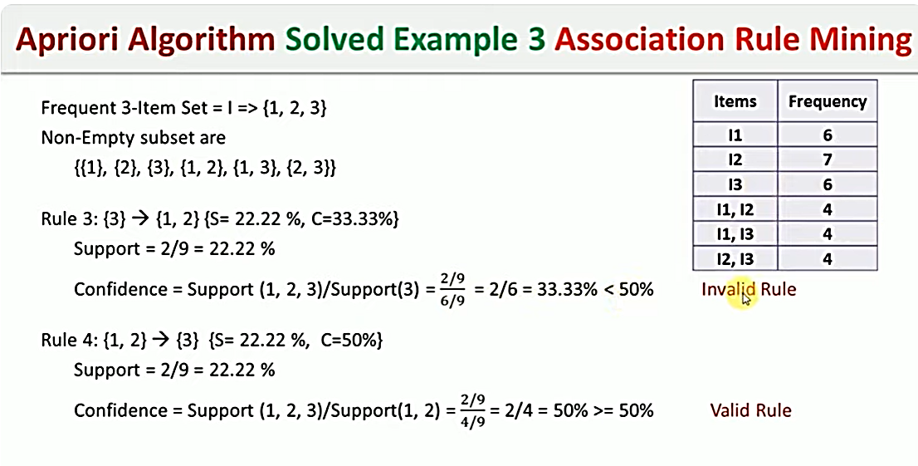

Slide 34
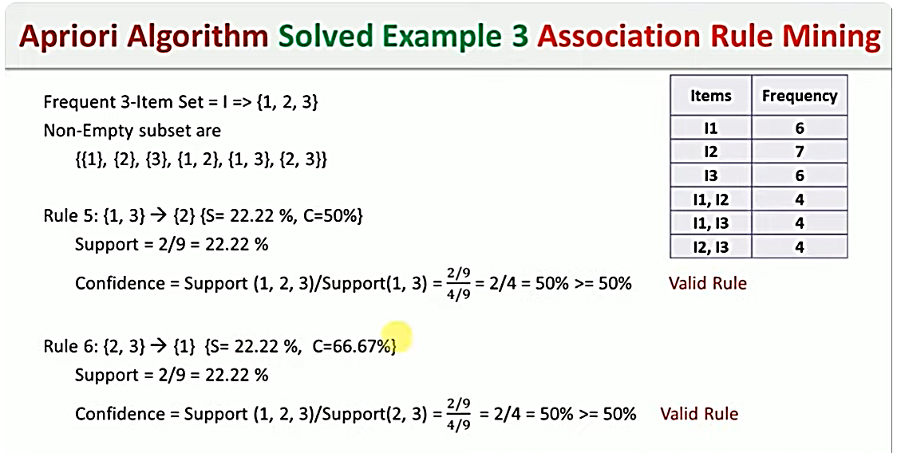

Slide 35
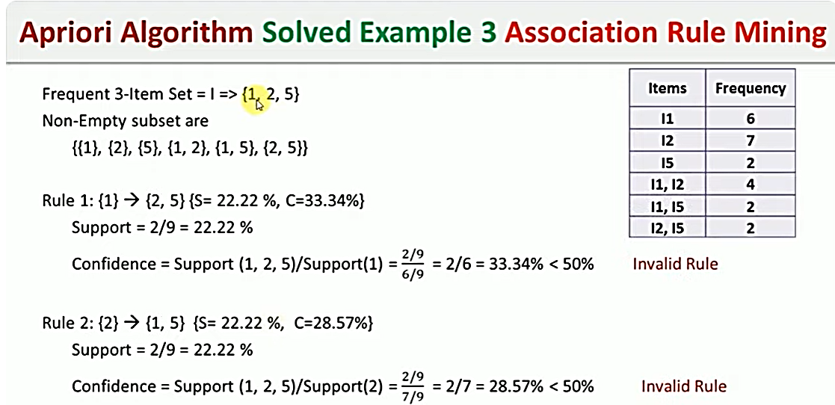

Slide 36
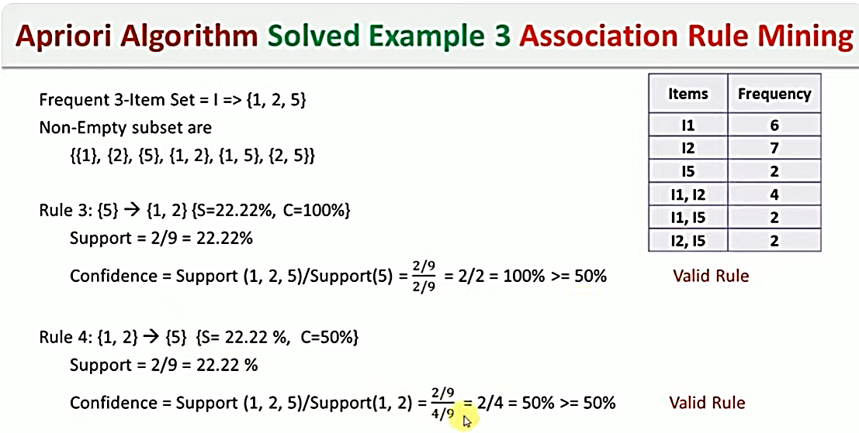

Slide 37
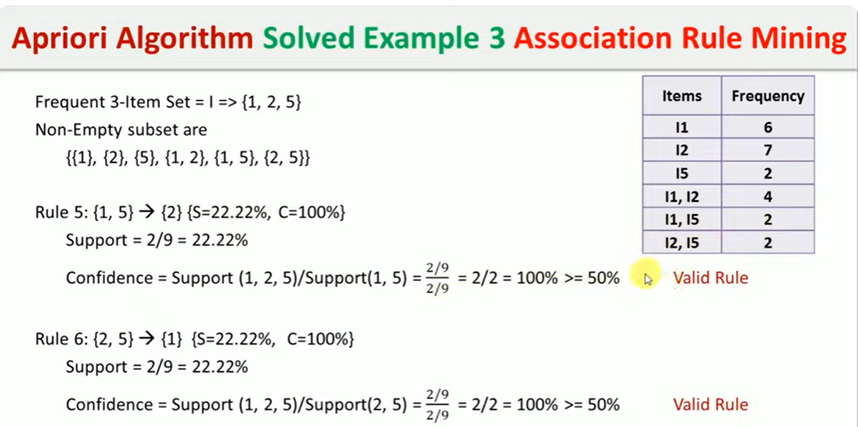

Slide 38
Apriori algorithm
There are various types of unsupervised machine learning techniques in ML like — clustering, dimensionality reduction, anomaly detection and association rules.
Apriori algorithm is an association rule based machine learning algorithm. Like all other unsupervised techniques this also doesn’t require you to train the model rather the system infers a function or find a pattern in the data to basically describe an hidden structure in your unlabelled dataset.
Apriori algorithm refers to an algorithm that is used in mining frequent products sets and relevant association rules. To put it simply, the apriori algorithm is an association rule leaning that analyses that people who bought product A also bought product B. What association based algorithms do, is that basically go through the entire data to find out if there any unique and different patterns in the data and hence apriori is also called frequent pattern mining.

Slide 39
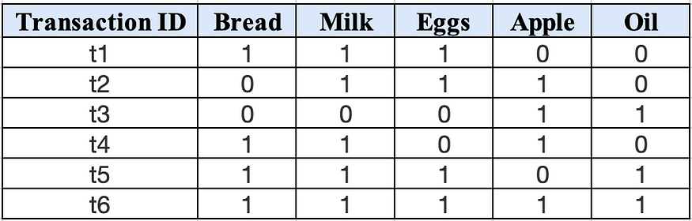
Apriori algorithm
The apriori is generally run on a very large database with a lot of transactions of various different products. So lets take an example, suppose you own a supermarket and sell various items there and want to know which are the items that are bought together and hence want to see how you can put a sale or clear your stock or any other business and profit based decision you want to make. So your dataset you are working with may look like this —
So, here as you can see that the supermarket has the following items, product set P = {Bread, Milk, Eggs, Apple, Oil} and the the transactions show what people have bought.
Notes:
https://kaumadiechamalka100.medium.com/apriori-algorithm-f7fb30793274

Slide 40
Few key terms you should know here are -
Itemset — the items clubbed together like {Bread, Milk, Eggs} form an itemset and a k-itemset contains k items within it.
Support Count — The frequency count of the occurring of a particular itemset becomes the support count for e.g., σ{Bread, Milk, Eggs} = 3
Support — It is the fraction of transactions that contain the itemset for e.g., s{Bread, Milk, Eggs} = 3/6
Frequent itemset — It is the itemset that has a support more than or equal to the minimum support, minimum support is defined by the user using the algorithm.
Association rule — It just the implication expression after the entire process that is of the form X → Y, e.g., {Bread, Milk} → {Eggs}
Confidence — This measures how often items in Y appear in transactions that contain X.
Lift — This measures how many times more often X and Y occur together than expected if they where statistically independent. This basically is measuring the dependent or correlated events.

Slide 41
Formula for support, confidence and lift—
Support(A) = (No. of transactions in which A appears) / (Total no. of transactions)
Confidence(A → B) = Support(A U B) / Support(A)
lift(A → B) = Support(A,B) / {Support(A).Support(B)}
Association rule mining concepts —
Given a set of transactions, T the goal of association rule mining is to find rules having support ≥ minimum support threshold and confidence ≥ minimum confidence threshold
So next it is basically a brute-force approach which starts by listing all possible association rules then computing confidence and support for each of them and then pruning the rules that fail the minimum support and minimum threshold

Slide 42
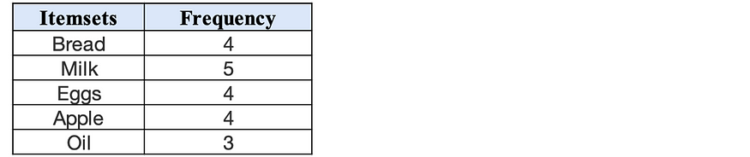
All this has a lot of calculations and hence this is computationally prohibitive approach, but for this blog we will be using this approach itself.
Lets first understand the Apriori principle — if an itemset is frequent then all its subsets must also be frequent. Which also means that — The subsets of an infrequent item set must be infrequent.
So, now lets solve this problem to get a basic understanding of apriori —
Lets generate the association rules for the above figure transactions considering the minimum support at 50% and minimum confidence at 50% using basic brute force apriori algorithm.
Step 1 —
Generate a frequency table for all items, basically the item and the number of transactions the item occurs in.

Slide 43
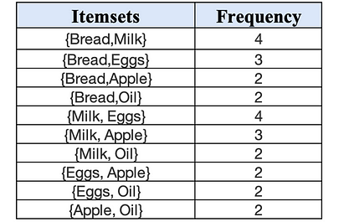
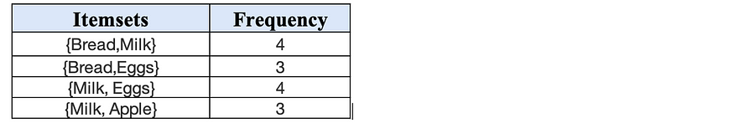
Step 2 —
Create a pair of items for all the above items creating a set of two items and then their frequency of occurring in the transactions.
Step 3 —
Check the count for the frequency. Since in our case we are taking a 50% minimum support threshold that would mean 50% of total transactions which is 3. So our minimum count is 3. So remove all below 3 and keep the rest.

Slide 44
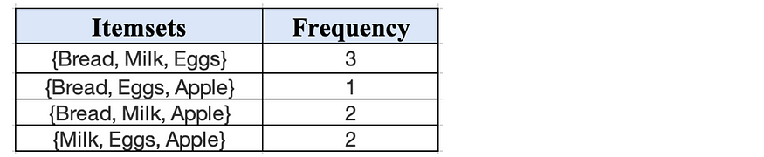
Step 4 —
Now if you want to generate the frequently bought together for 3 items repeating similarly we would have the itemsets and the frequency as given in the frequency table below.
If you see here, we generated the frequent itemsets from the above itemsets possible and then found the frequency count and our support is set at 3. So, the most frequently occurring 3 itemset combination of items is {Bread, Milk, Eggs}.

Slide 45
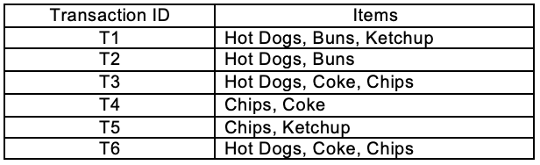
Apriori algorithm Example -1
Let’s see an example of the Apriori Algorithm.
Find the frequent itemsets and generate association rules on this. Assume that minimum support threshold (s = 33.33%) and minimum confident threshold (c = 60%)

Slide 46
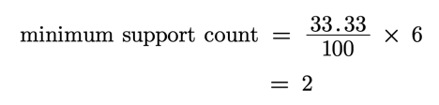
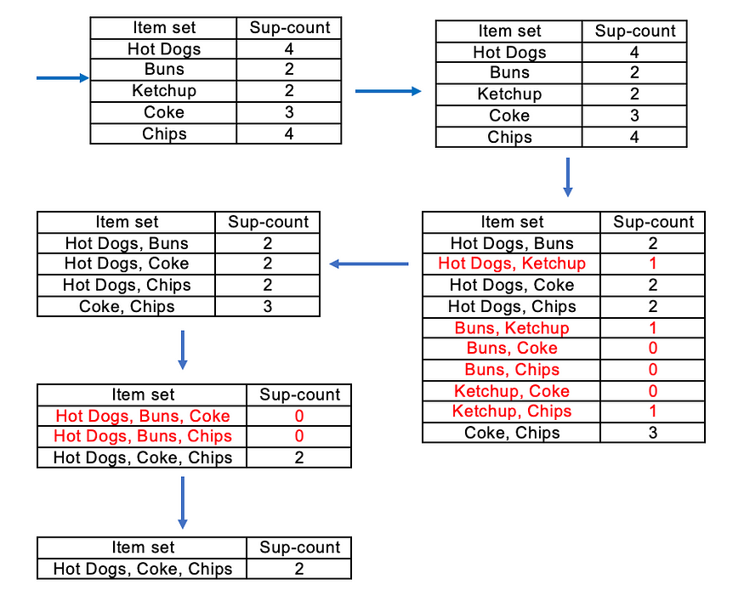
Apriori algorithm Example -1

Slide 47
Apriori algorithm Example -1
There is only one itemset with minimum support 2. So only one itemset is frequent.
Frequent Itemset (I) = {Hot Dogs, Coke, Chips}
Association rules,
[Hot Dogs^Coke]=>[Chips] //confidence = sup(Hot Dogs^Coke^Chips)/sup(Hot Dogs^Coke) = 2/2*100=100% //Selected
[Hot Dogs^Chips]=>[Coke] //confidence = sup(Hot Dogs^Coke^Chips)/sup(Hot Dogs^Chips) = 2/2*100=100% //Selected
[Coke^Chips]=>[Hot Dogs] //confidence = sup(Hot Dogs^Coke^Chips)/sup(Coke^Chips) = 2/3*100=66.67% //Selected
[Hot Dogs]=>[Coke^Chips] //confidence = sup(Hot Dogs^Coke^Chips)/sup(Hot Dogs) = 2/4*100=50% //Rejected
[Coke]=>[Hot Dogs^Chips] //confidence = sup(Hot Dogs^Coke^Chips)/sup(Coke) = 2/3*100=66.67% //Selected
[Chips]=>[Hot Dogs^Coke] //confidence = sup(Hot Dogs^Coke^Chips)/sup(Chips) = 2/4*100=50% //Rejected
There are four strong results (minimum confidence greater than 60%)

Slide 48
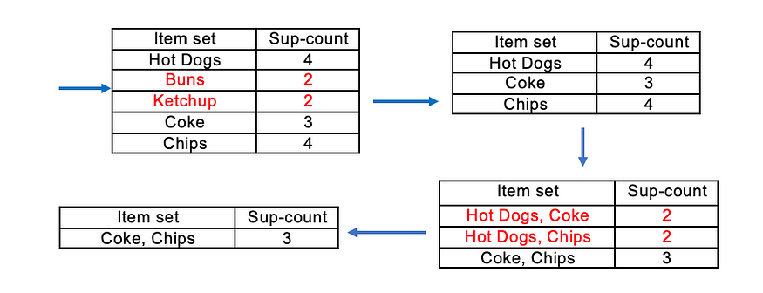
Apriori algorithm Example -2
Let’s see another example of the Apriori Algorithm.
Find the frequent itemsets on this. Assume that minimum support (s = 3)
There is only one itemset with minimum support 3. So only one itemset is frequent.
Frequent Itemset (I) = {Coke, Chips}

Slide 49
LDA
https://www.youtube.com/watch?v=wvz_aJA_mfs

Slide 50
Thank You

